Slide 1
CPU Processor Speed Timeline

Slide 2
8008
Speed = .02 Mhz
Year= 1972
Transistors= 3500
It takes 66,600 8008 CPU’s to equal 1 i7.

Slide 3
8080
Speed= 2 Mhz
Year= 1974
Transistors= 6000
It takes 6,660 8080 CPU’s to equal 1 i7.

Slide 4
8085
Speed= 5 Mhz
Year= 1976
Transistors= 6500
It takes 2,664 8085 CPU’s to equal 1 i7.

Slide 5
8086
Speed= 10 Mhz
Year= 1978
Transistors= 29,000
It takes 1,332 8086 CPU’s to equal 1 i7.

Slide 6
286
Speed= 12Mhz
Year= 1982
Transistors= 134,000
It takes 1,110 286 CPU’s to equal 1 i7.

Slide 7
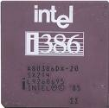
386
Speed= 20 Mhz
Year= 1985-87
Transistors= 275,000
It takes 666 386 CPU’s to equal 1 i7.

Slide 8
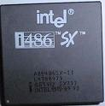
486
Speed= 50 Mhz
Year= 1989-91
Transistors= 1.2 million
It takes 266.4 486 CPU’s to equal 1 i7.

Slide 9
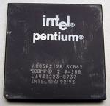
Pentium
Speed= 200 Mhz
Year= 1993-96
Transistors= 3.3 million
It takes 66.6 Pentium CPU’s to equal 1 i7.

Slide 10
Pentium 2
Speed= 450 Mhz
Year= 1997-98
Transistors= 7.5 million
It takes 29.6 Pentium 2 CPU’s to equal 1 i7.

Slide 11
Pentium 3
Speed= 1000 Mhz
Year= 1999- 2000
Transistors= 28 Million
It takes 13.3 Pentium 3 CPU’s to equal 1 i7.

Slide 12
Pentium 4
Speed= 3400 Mhz
Year= 2000-04
Transistors= 55 Million
It takes 3.9 Pentium 4 CPU’s to equal 1 i7.

Slide 13
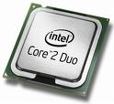
Core 2 Duo
Speed= 6660
Year= 2006
Transistors= 253 Million
It takes 2 Core Duo CPU’s to equal 1 i7.

Slide 14
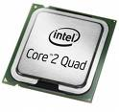
Core 2 Quad
Speed= 11,200 Mhz
Year= 2008
Transistors= ?
It takes 1.2 Core 2 Quad CPU’s to equal 1 i7.

Slide 15
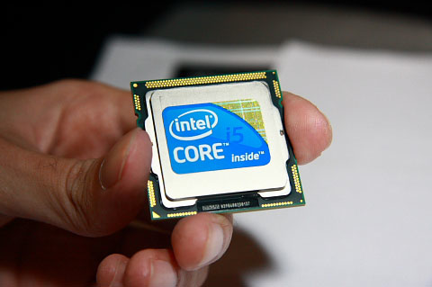
Core i5
Speed= 10,640 Mhz
Year= 2009
Transistors=
It takes 1.2 Core i5 CPU’s to equal 1 i7.

Slide 16
Core i7
Speed= 13,320 Mhz
Year= 2010
Transistors=
This is 1 i7 CPU.

