Slide 1
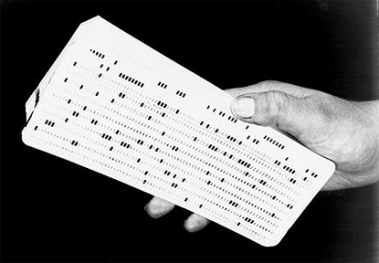

Slide 2
960 Bits or 120 Bytes

Slide 3
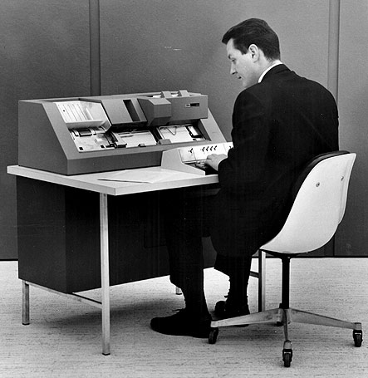

Slide 4
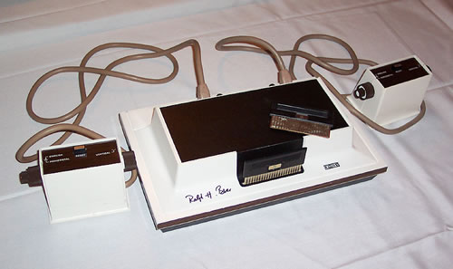
Magnavox Odyssey

Slide 5
41 Punch Cards

Slide 6
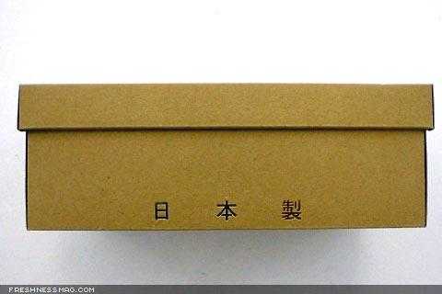
500 Punch Cards = 1 Shoebox

Slide 8
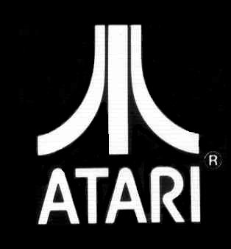
Atari

Slide 9
1/2 Shoe Box

Slide 10
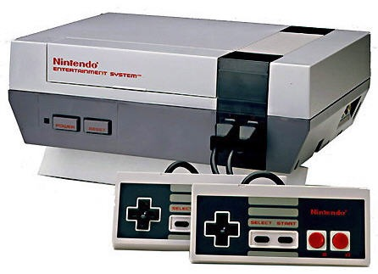
NES

Slide 11
16 Shoe Boxes

Slide 12
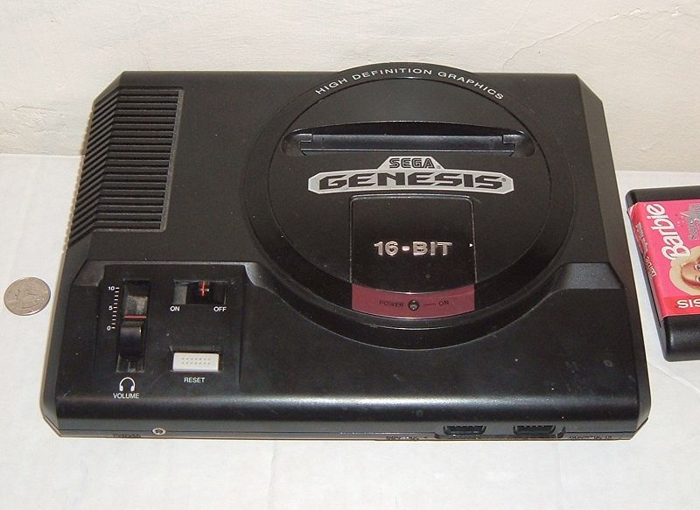
Genesis

Slide 13
265 Shoe Boxes

Slide 14
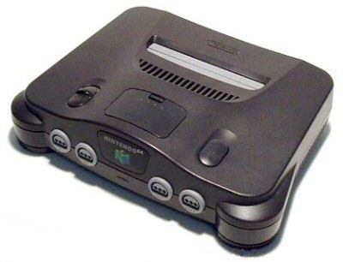
N64

Slide 15
533 Shoe Boxes

Slide 16
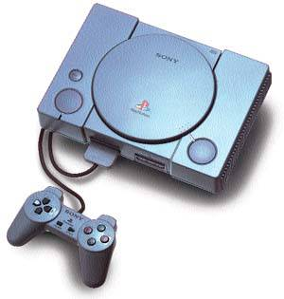
Playstation 1

Slide 17
7,462 Shoe Boxes

Slide 18
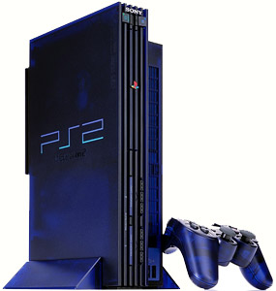
Playstation 2

Slide 19
70,142 Shoe Boxes

Slide 20
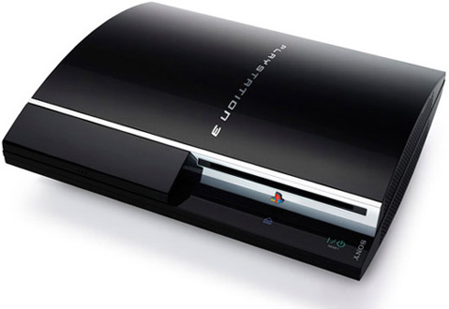

Slide 21
210,426 Shoe Boxes

Slide 22
Blah

Slide 23
If it were 1948,

Slide 24
And you had a PS 3 game Disc,

Slide 25
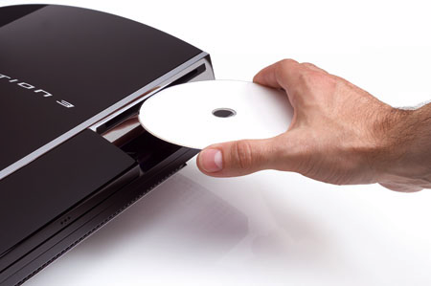

Slide 26
You would need space for: 210,426 Million Shoe Boxes

Slide 27
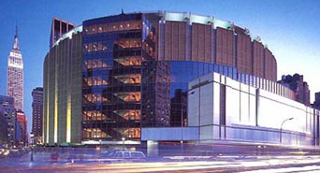
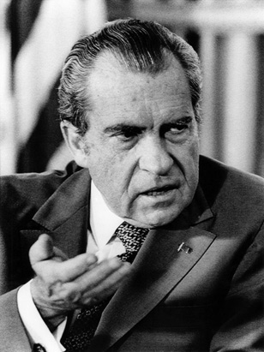
Or a House:
the size of 6 Madison Square Gardens !

